Slide 1
AI-Powered Virtual Nutrition Assistant
IBM Cloud Internship Project
Presented By:
Student Name-Prasann Kumar
College Name-Guru Nanak Dev Engg. College
Department-Computer Science and Engg.

Slide 2
outline
Problem Statement
Proposed Solution
System Approach
Algorithm
Result
Conclusion
Future Scope
Wow Factor
References
IBM Certifications
Github Link

Slide 3
Problem Statement
Nutrition Agent The Challenge - In an era where health awareness is growing, individuals increasingly seek personalized nutrition guidance. However, most existing tools provide generic diet plans, lack real-time adaptability, and fail to consider a person's holistic lifestyle, cultural preferences, allergies, and evolving health conditions. Furthermore, dieticians and nutritionists face limitations in scaling personalized consultations due to time and resource constraints. Generative AI presents a groundbreaking opportunity to revolutionize this space by enabling an intelligent, interactive, and adaptive virtual nutrition assistant. By leveraging natural language processing (NLP), multimodal understanding, and large-scale dietary databases, an AI-powered assistant can generate dynamic meal plans, recommend smart food swaps, and explain nutritional choices—all tailored to the individual.

Slide 4
Proposed Solution
“The Smartest AI Nutrition Assistant”
Overview
Our proposed solution is an AI-powered virtual nutrition assistant that uses IBM Watsonx and IBM Cloud Lite services to deliver personalized, adaptive, and multimodal nutritional guidance. The system leverages generative AI capabilities, voice and image processing, and contextual reasoning to help users meet their health goals with dynamic meal planning, food explanations, and real-time adaptability.
Key Features Implemented
1. Multimodal Input Processing (Text, Voice, Image)
-Text Input: Users can interact with the assistant via a natural chat interface.
-Voice Input: Integrated voice-to-text API allows users to speak queries, making the assistant accessible to visually impaired or elderly users.
-Image Input: Users can upload food plate images or grocery labels. The system uses OCR and image classification (IBM Watson Visual Recognition or custom CNN) to recognize food items.

Slide 5
2. Personalized Meal Plan Generation
Dynamically generated meal plans are tailored based on:
Health goals (e.g., weight loss, muscle gain, diabetes management)
Medical conditions (e.g., hypertension, lactose intolerance)
Food allergies and preferences (e.g., vegetarian, gluten-free)
Activity and fitness level
IBM Granite LLMs reason over structured and unstructured health inputs to build customized meal plans.
3. Smart Food Swap and Recommendations
Suggests healthier alternatives using food databases (e.g., swapping white rice with quinoa).
Recognizes user cultural context, dietary preferences, and budget limitations.
4. Contextual Nutritional Explanations
Each food item or swap includes why it is recommended:
“This food is high in Omega-3, which supports heart health.”
“Brown rice has a lower glycemic index than white rice, making it better for diabetics.”
Enhances user trust and learning.
5. Feedback Loop and Adaptation
The assistant remembers feedback (e.g., “I don’t like oats”).
Uses adaptive reasoning (via Watsonx LLM) to refine suggestions over time.
Supports daily logs to track user mood, hunger levels, and compliance to the plan.

Slide 6
System Approach
Problem Identification: Lack of personalized and adaptive nutrition guidance in existing solutions.
Objective: Build an AI assistant that understands user input (text, voice, image), provides dynamic meal
plans, and explains food choices using IBM Cloud services.
System Analysis:
Understand user needs (health goals, preferences, allergies)
Define functional (meal planning, explanation) and non-functional (real-time, scalable) requirements
System Design:
Modules: Input Processing → AI Reasoning Engine → Meal Plan Generator → Feedback Loop
Technologies: IBM Watsonx, Granite LLMs, Cloudant DB, Speech-to-Text, Visual Recognition
System Implementation:
Integrated multimodal input
Generated personalized meal plans using LLMs
Stored user data securely in the cloud
System Testing & Evaluation:
Verified input processing, meal plan accuracy, user feedback adaptation
Ensured usability, scalability, and explainability

Slide 7
Algorithm
1.Start
2.Login to IBM Cloud
Go to https://cloud.ibm.com
Sign in with IBM ID
3.Create New Project
Navigate to Watsonx.ai
Click on Projects → Create a Project
Name the project: ______________
Choose Lite Plan
4.Set Up Services
Add Service: Watsonx.ai
Choose Granite LLMs under Foundation Models
Add Service: Object Storage
Select IBM Cloud Object Storage (Lite)
Bind it to the project for storing image/voice/text logs
5.Enter Prompt Lab
Go to Prompt Lab inside Watsonx.ai Studio
Choose a Granite model (e.g., Granite-13b-instruct)
Name the Prompt Lab: Smart Nutrition Agent

Slide 8
Select Input Mode: Prompt template
6.Define Prompt Template
Start building prompt like:
“You are a nutrition expert. Based on user input, suggest a healthy, personalized meal plan...”
Set variables for: age, gender, goals, preferences, allergies, current meals, etc.
7.Handle User Input
Text Input:
User enters text like: “I want a weight-loss plan, I’m vegetarian.”
Voice Input:
Use IBM Speech-to-Text (Lite) to convert speech into text
Image Input:
Use Watson Visual Recognition or a CNN model
Extract food names or nutrition labels using OCR
8.Process Input via Prompt Lab
Pass extracted input (e.g., “Vegetarian, weight loss, Indian diet”) into the Granite prompt
Granite LLM generates:
Personalized meal plan
Explanation for each item
Smart food swaps

Slide 9
9.Display Output to User
Render results in UI or CLI:
Meal Plan (breakfast/lunch/dinner/snacks)
Nutritional reasoning: “This is low in calories and high in fiber.”
Image tags or voice transcript as reference
10.Accept Feedback (Optional)
User says: “I don’t like oats”
Store feedback in Cloudant DB
Update user profile dynamically
11.Store Session Data
Use Object Storage or Cloudant DB to store:
Inputs (text/voice/image)
Outputs (meal plan, reasoning)
User preferences
12.Iterate if Needed
Let user ask for revised plan or explain a specific food choice
13.End

Slide 10
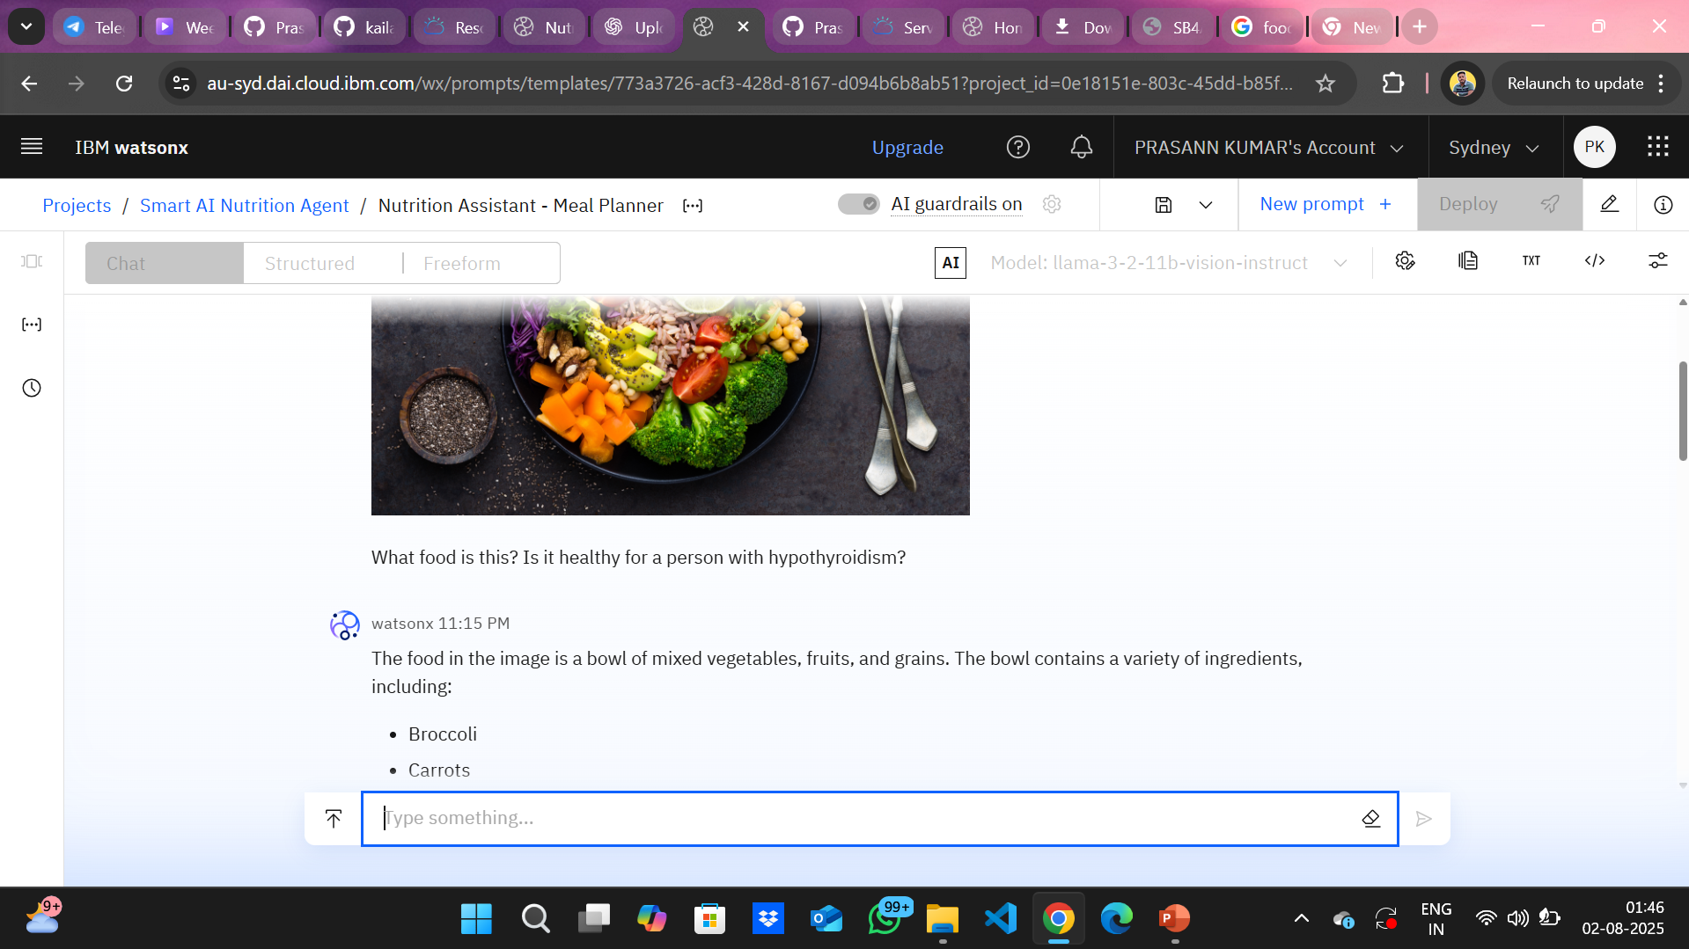
Result
1.PROMPT LAB INTERFACE

Slide 11
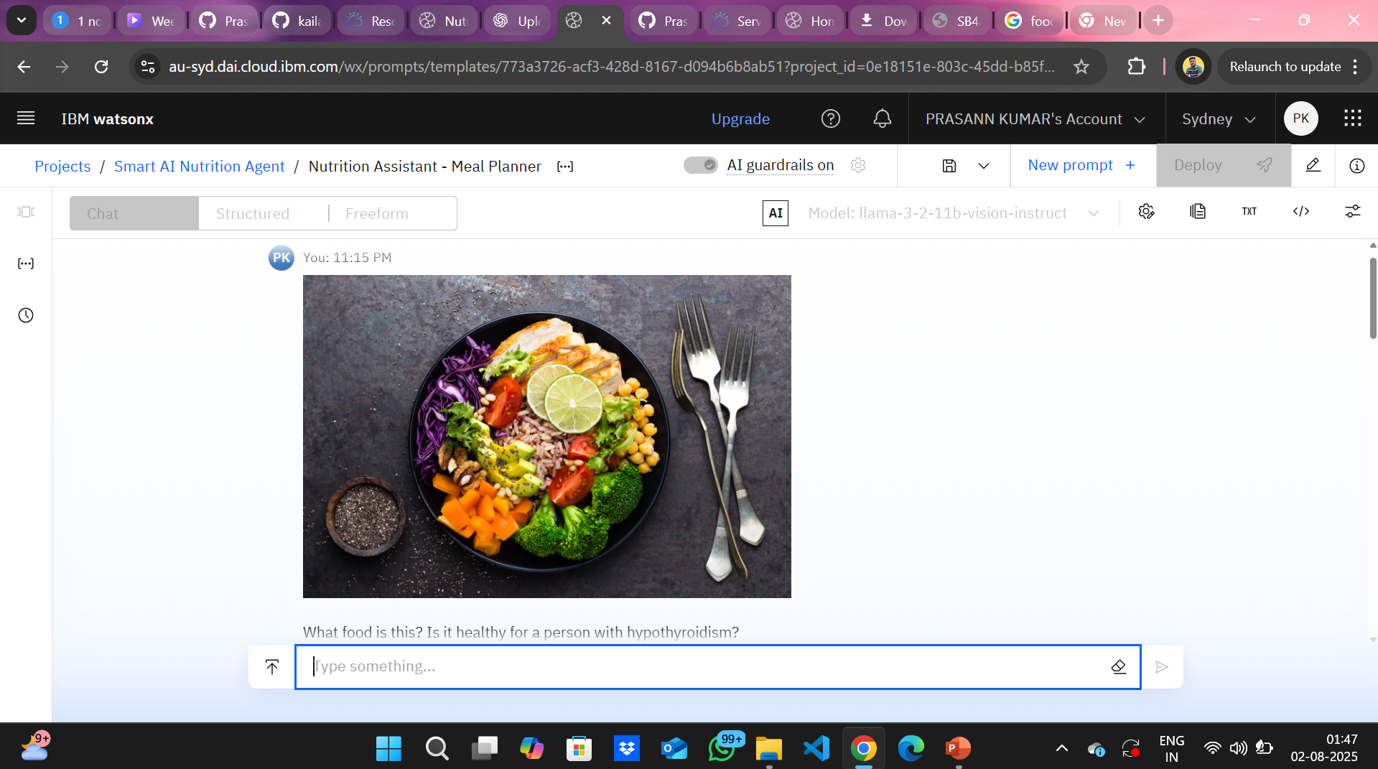
2.IMAGE INPUT TO OUTPUT

Slide 12
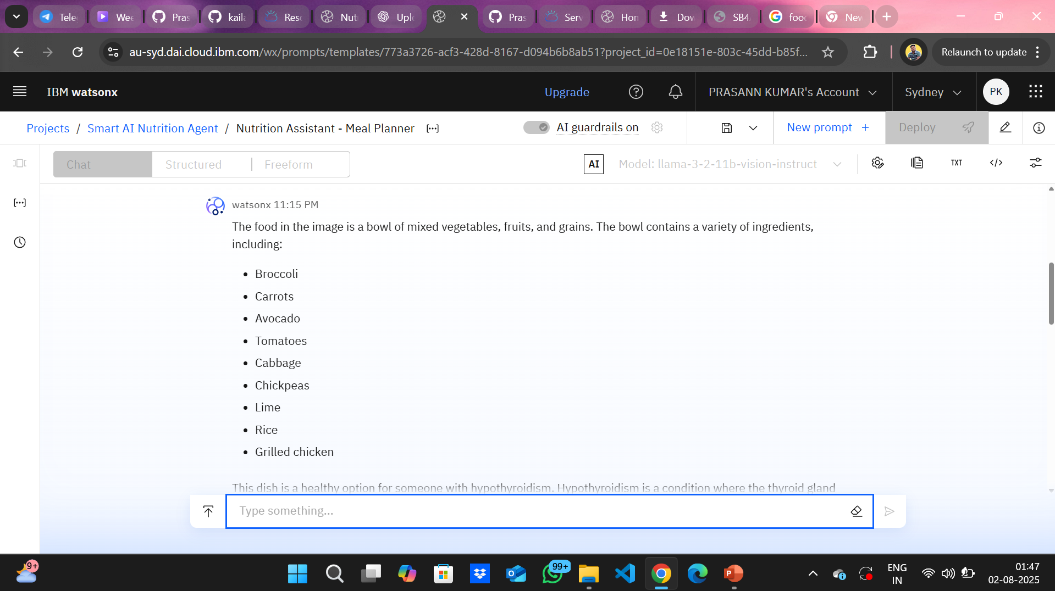

Slide 13
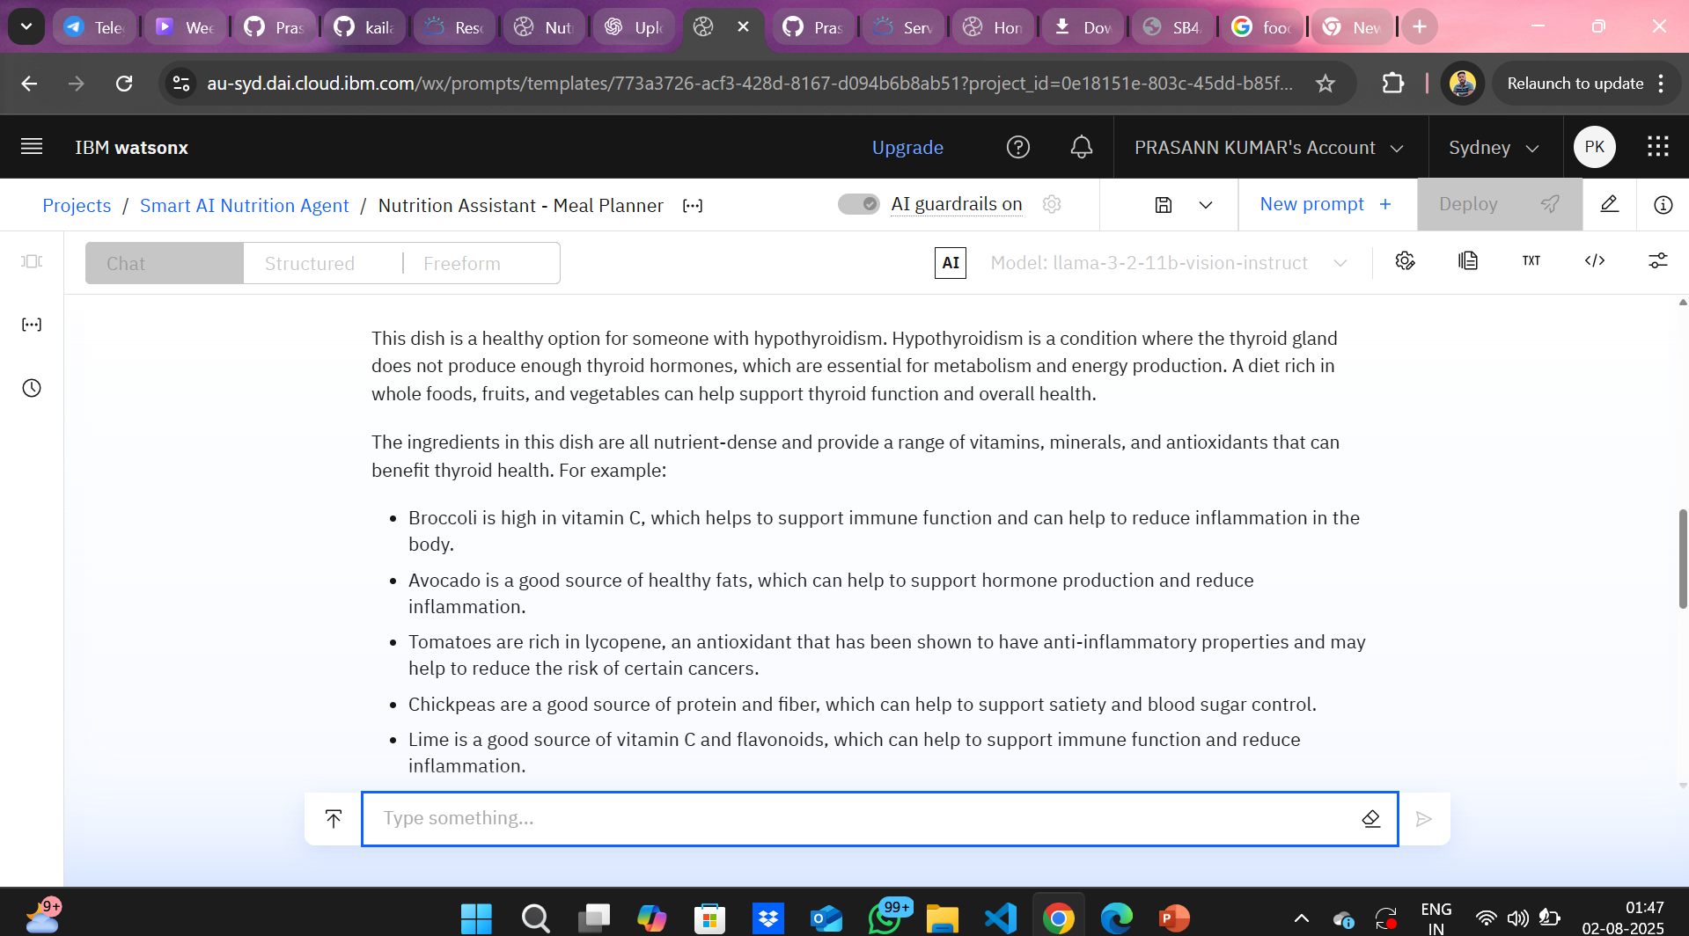

Slide 14
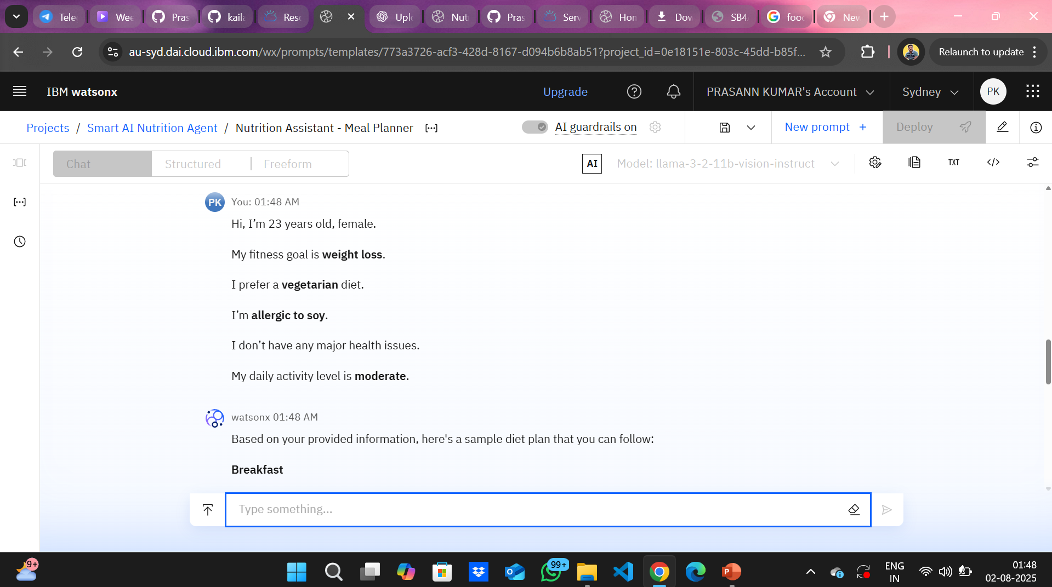
3.TEXT INPUT TO OUTPUT

Slide 15
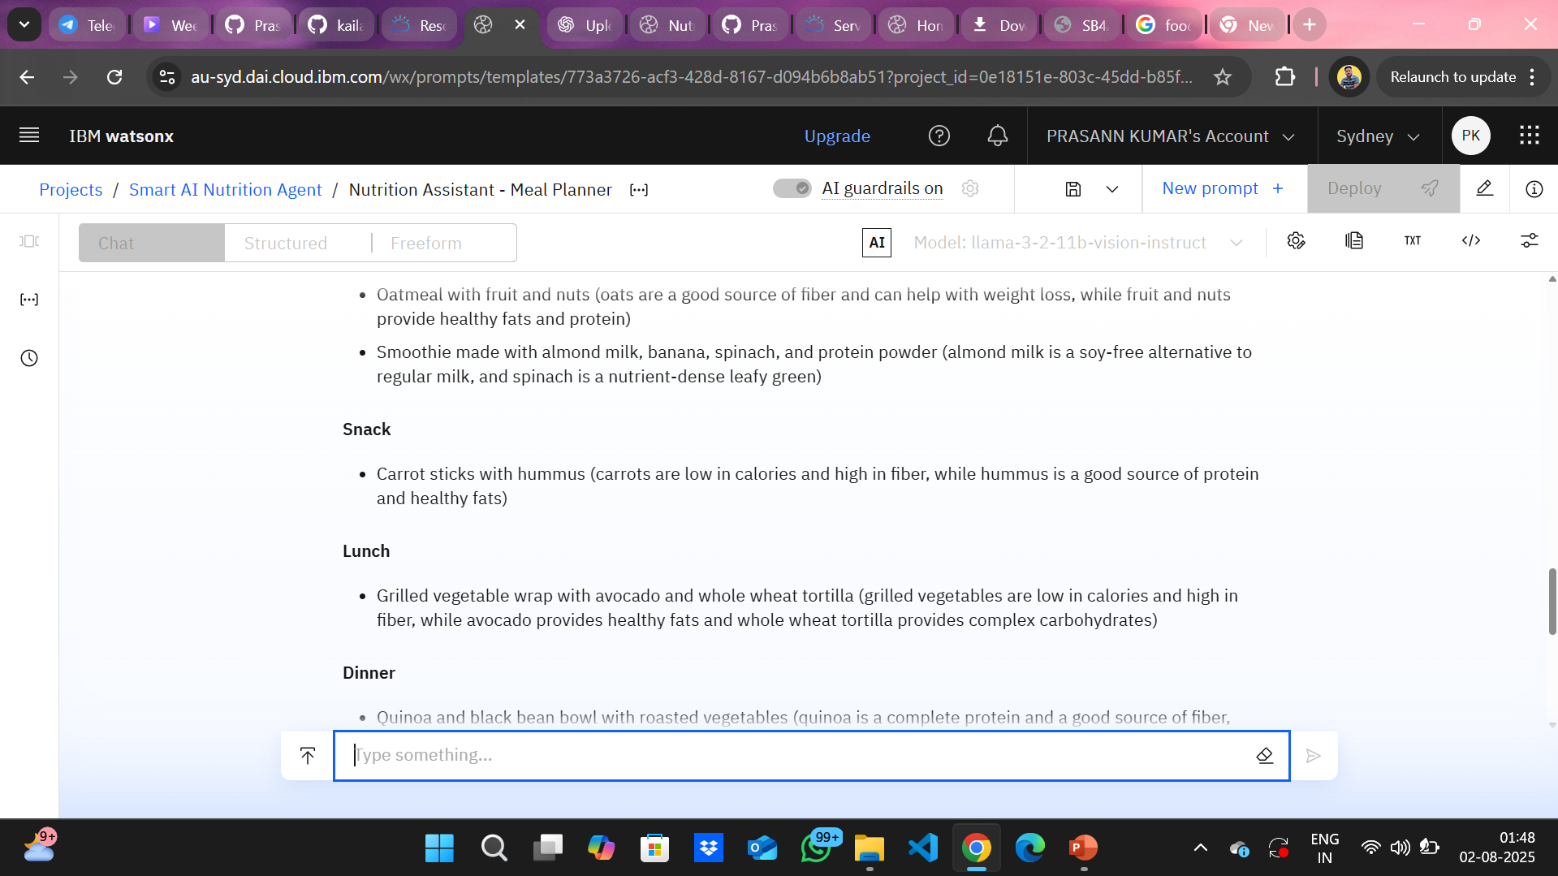

Slide 16
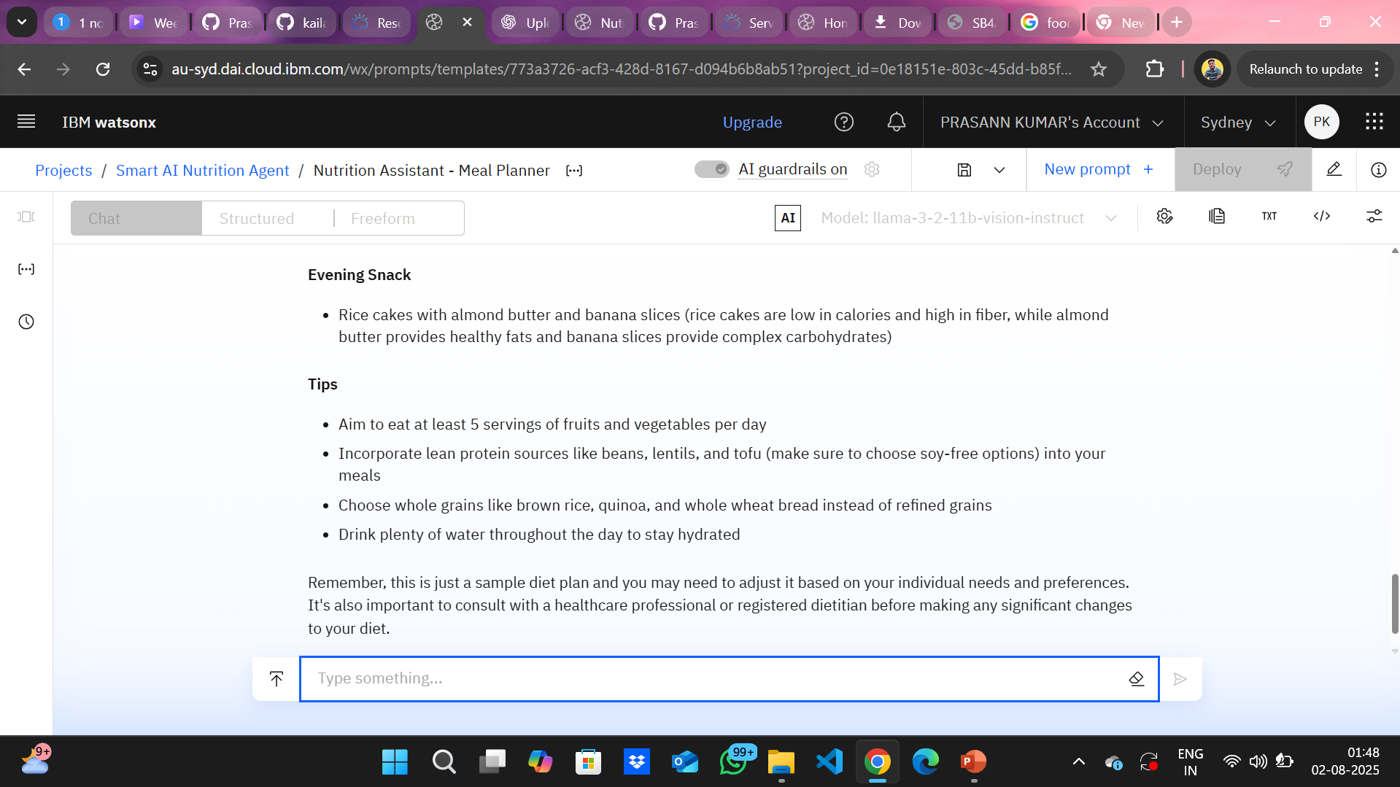

Slide 17
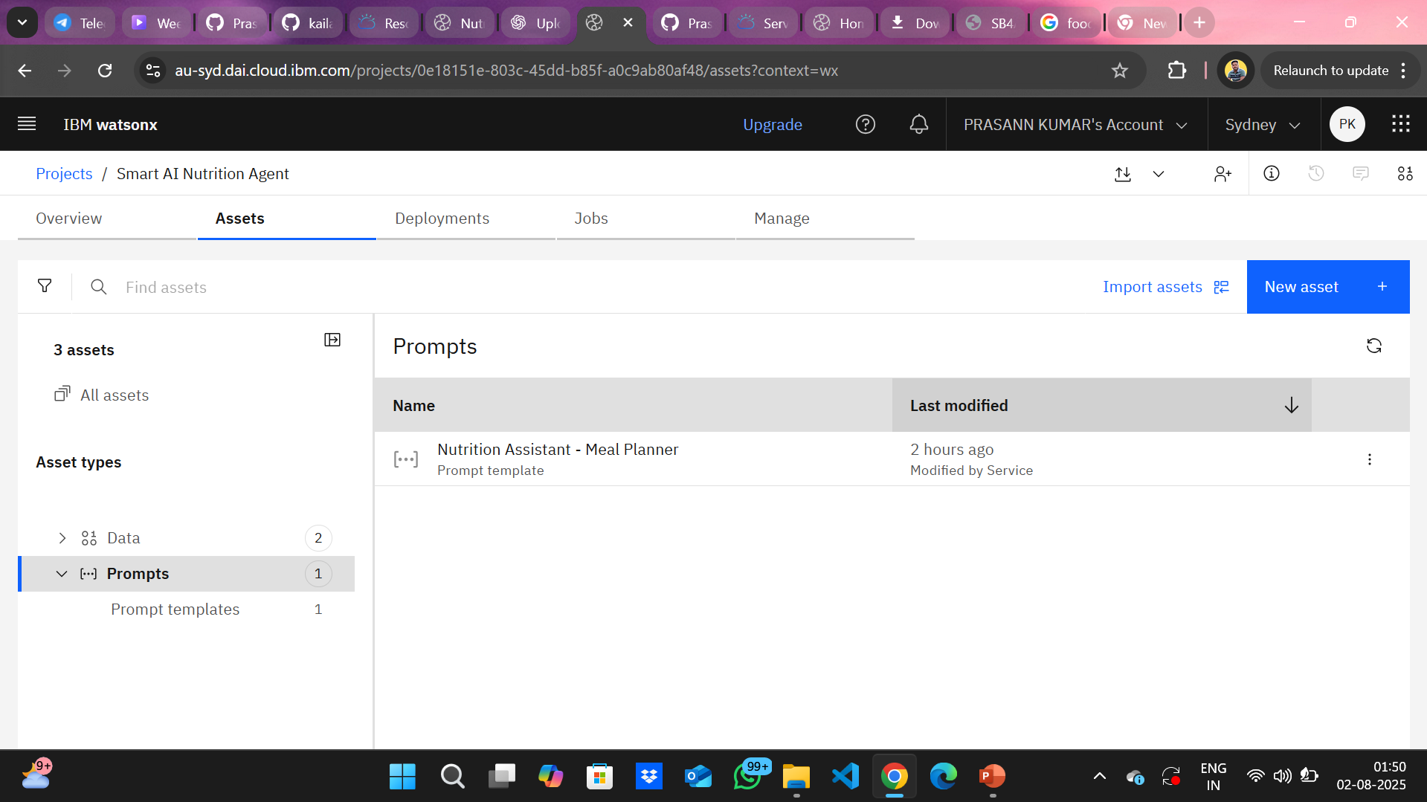
4.SAVED PROMPT

Slide 18
Conclusion
The AI-powered Nutrition Assistant, developed using IBM Cloud Lite services and Watsonx.ai, successfully demonstrates how cutting-edge generative AI can revolutionize personalized healthcare. By integrating multimodal inputs (text, voice, image), leveraging Granite LLMs for contextual understanding, and dynamically generating meal plans tailored to individual goals, the solution bridges the critical gap between generic diet apps and real-time human nutrition counseling.
The assistant not only delivers customized and explainable nutrition plans, but also learns continuously from user feedback—making it adaptive, intelligent, and truly user-centric. This project highlights the vast potential of AI in making wellness more accessible, scalable, and interactive, setting a strong foundation for future advancements in digital health and virtual care solutions.
In essence, this Smart Nutrition Assistant is more than a chatbot—it's a step toward building an AI that thinks, learns, and cares like a real nutrition expert.

Slide 19
Future scope
1.Integration with Wearables and Health Apps
Sync with fitness trackers (like Fitbit, Apple Health, Google Fit) to get real-time health data (steps, heart rate, calories burned) and offer more accurate meal planning.
2.Multilingual and Regional Support
Enable support for multiple Indian and global languages and local cuisines to make the assistant more inclusive and culturally relevant.
3.Advanced Visual Recognition
Upgrade image analysis to not just detect food but also estimate portion size and calorie count directly from a food photo.
4.Medical Record Integration
Connect with user health records (with consent) to auto-consider chronic conditions like diabetes, PCOD, or cholesterol issues during meal planning.
5AI-Powered Grocery Planner
Recommend grocery lists based on weekly meal plans and suggest healthy alternatives while shopping via camera input (scan and compare).

Slide 20
6.Voice Assistant Deployment
Deploy the assistant on smart devices like Alexa, Google Assistant, or WhatsApp chatbot for real-time voice interaction and daily nutrition check-ins.
7.Gamification and Progress Tracking
Add goal tracking, reward systems, and progress charts to motivate users and make healthy eating engaging and fun.
8.Data-Driven Personalization with Feedback Loops
Use long-term user data to continuously optimize meal plans using reinforcement learning or AutoAI.

Slide 21
WOW FACTOR
✅ Multimodal Input – Supports text, voice & image for all user types
🧠 IBM Granite LLMs – Delivers smart, human-like nutrition advice
🥗 Personalized Meal Plans – Based on health, culture, and preferences
💬 Food Reasoning – Explains why each item is recommended
🔁 Adaptive Learning – Adjusts plans from user feedback
📷 Food Image Detection – Understands meals from photos
☁️ Fully IBM Cloud-Based – Watsonx, Cloudant, Object Storage, etc.
🧾 Scalable & Affordable – Runs 24×7 without human cost
📊 Deployment-Ready – Easily extendable to apps & chatbots
🔐 Secure & Private – Stores data safely using IBM Cloud

Slide 22
References
IBM Cloud – https://cloud.ibm.com
IBM Watsonx.ai Documentation – https://www.ibm.com/docs/en/watsonx
IBM Granite LLM Models – https://www.ibm.com/products/granite
IBM Cloud Object Storage – https://www.ibm.com/cloud/object-storage
IBM Cloudant Database – https://www.ibm.com/cloud/cloudant
IBM Speech to Text Service – https://www.ibm.com/cloud/speech-to-text
NutritionIX API – https://developer.nutritionix.com
USDA FoodData Central – https://fdc.nal.usda.gov
WHO Nutrition Guidelines – https://www.who.int/health-topics/nutrition
Research Articles on AI in Nutrition – Google Scholar- https://scholar.google.com

Slide 23
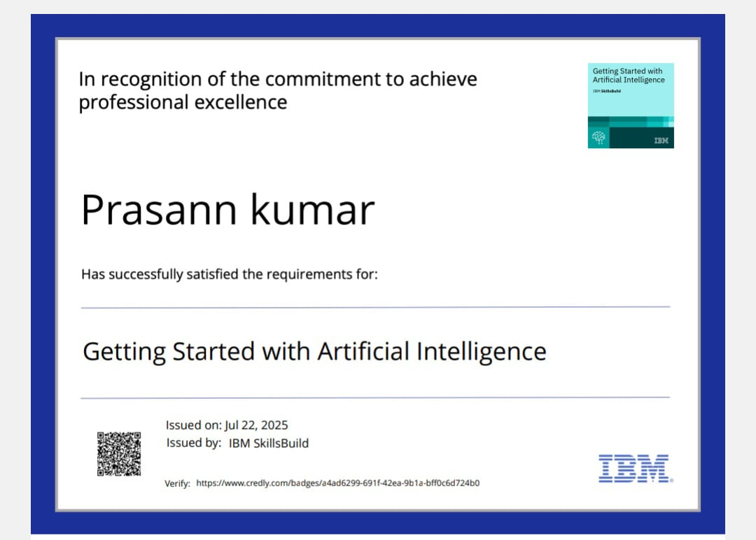
IBM Certifications
Screenshot/ credly certificate( getting started with AI)

Slide 24
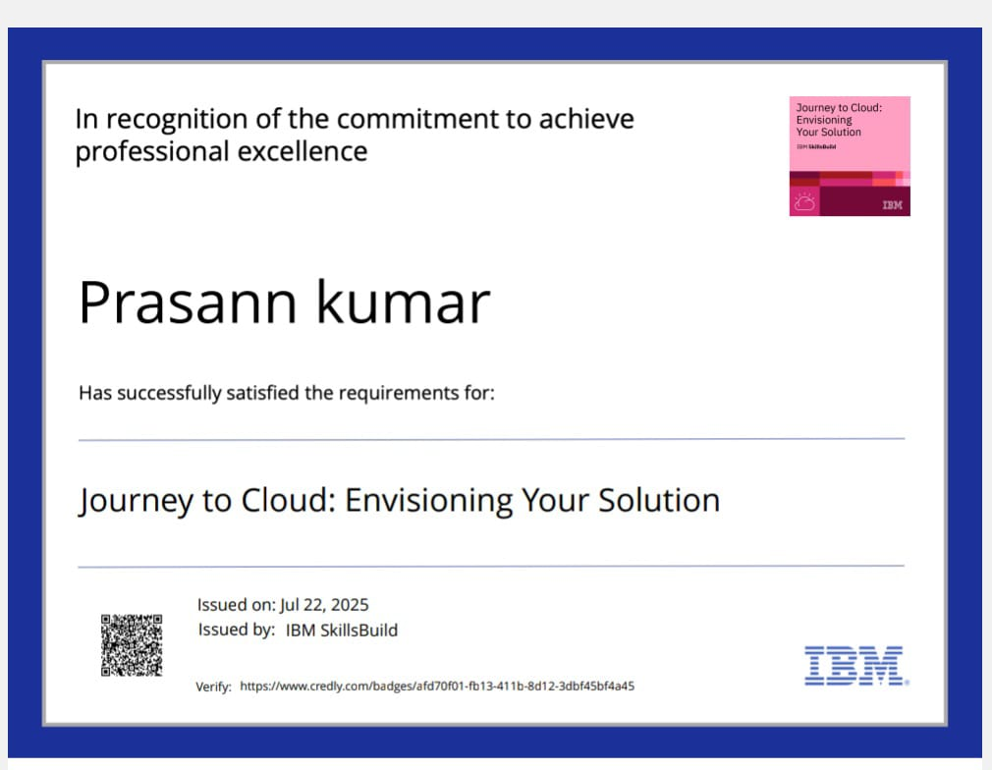
IBM Certifications
Screenshot/ credly certificate( Journey to Cloud)

Slide 25
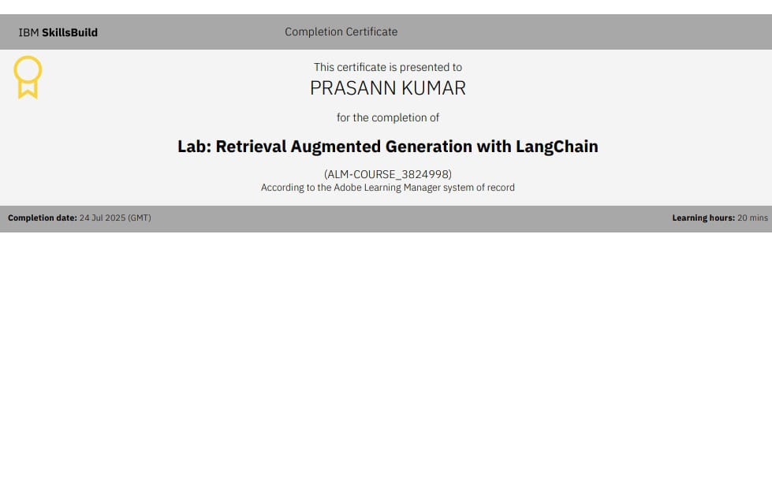
IBM Certifications
Screenshot/ credly certificate( RAG Lab)

Slide 26
GITHUB lINK
GITHUB - https://github.com/Prasann2003/nutrition-assistant

Slide 27
THANK YOU

